Slide 1
DATA 604 Final Project Bank Teller Simulation

Slide 2
Introduction
Bank executives don't want to hire too many teller because of the online options that a lot of customers use currently, and having just few teller can cause customers to wait in line for so long, which cause customer dissatisfaction especially senior citizens and customers that use cash transaction in their daily life. This simulation program is to help bank executives to determine the best number of tellers they need to hire.
This study excludes the clients that need to open accounts, apply for mortgages, etc, but it including only clients with routine transactions such as deposit, withdrawal, etc

Slide 3
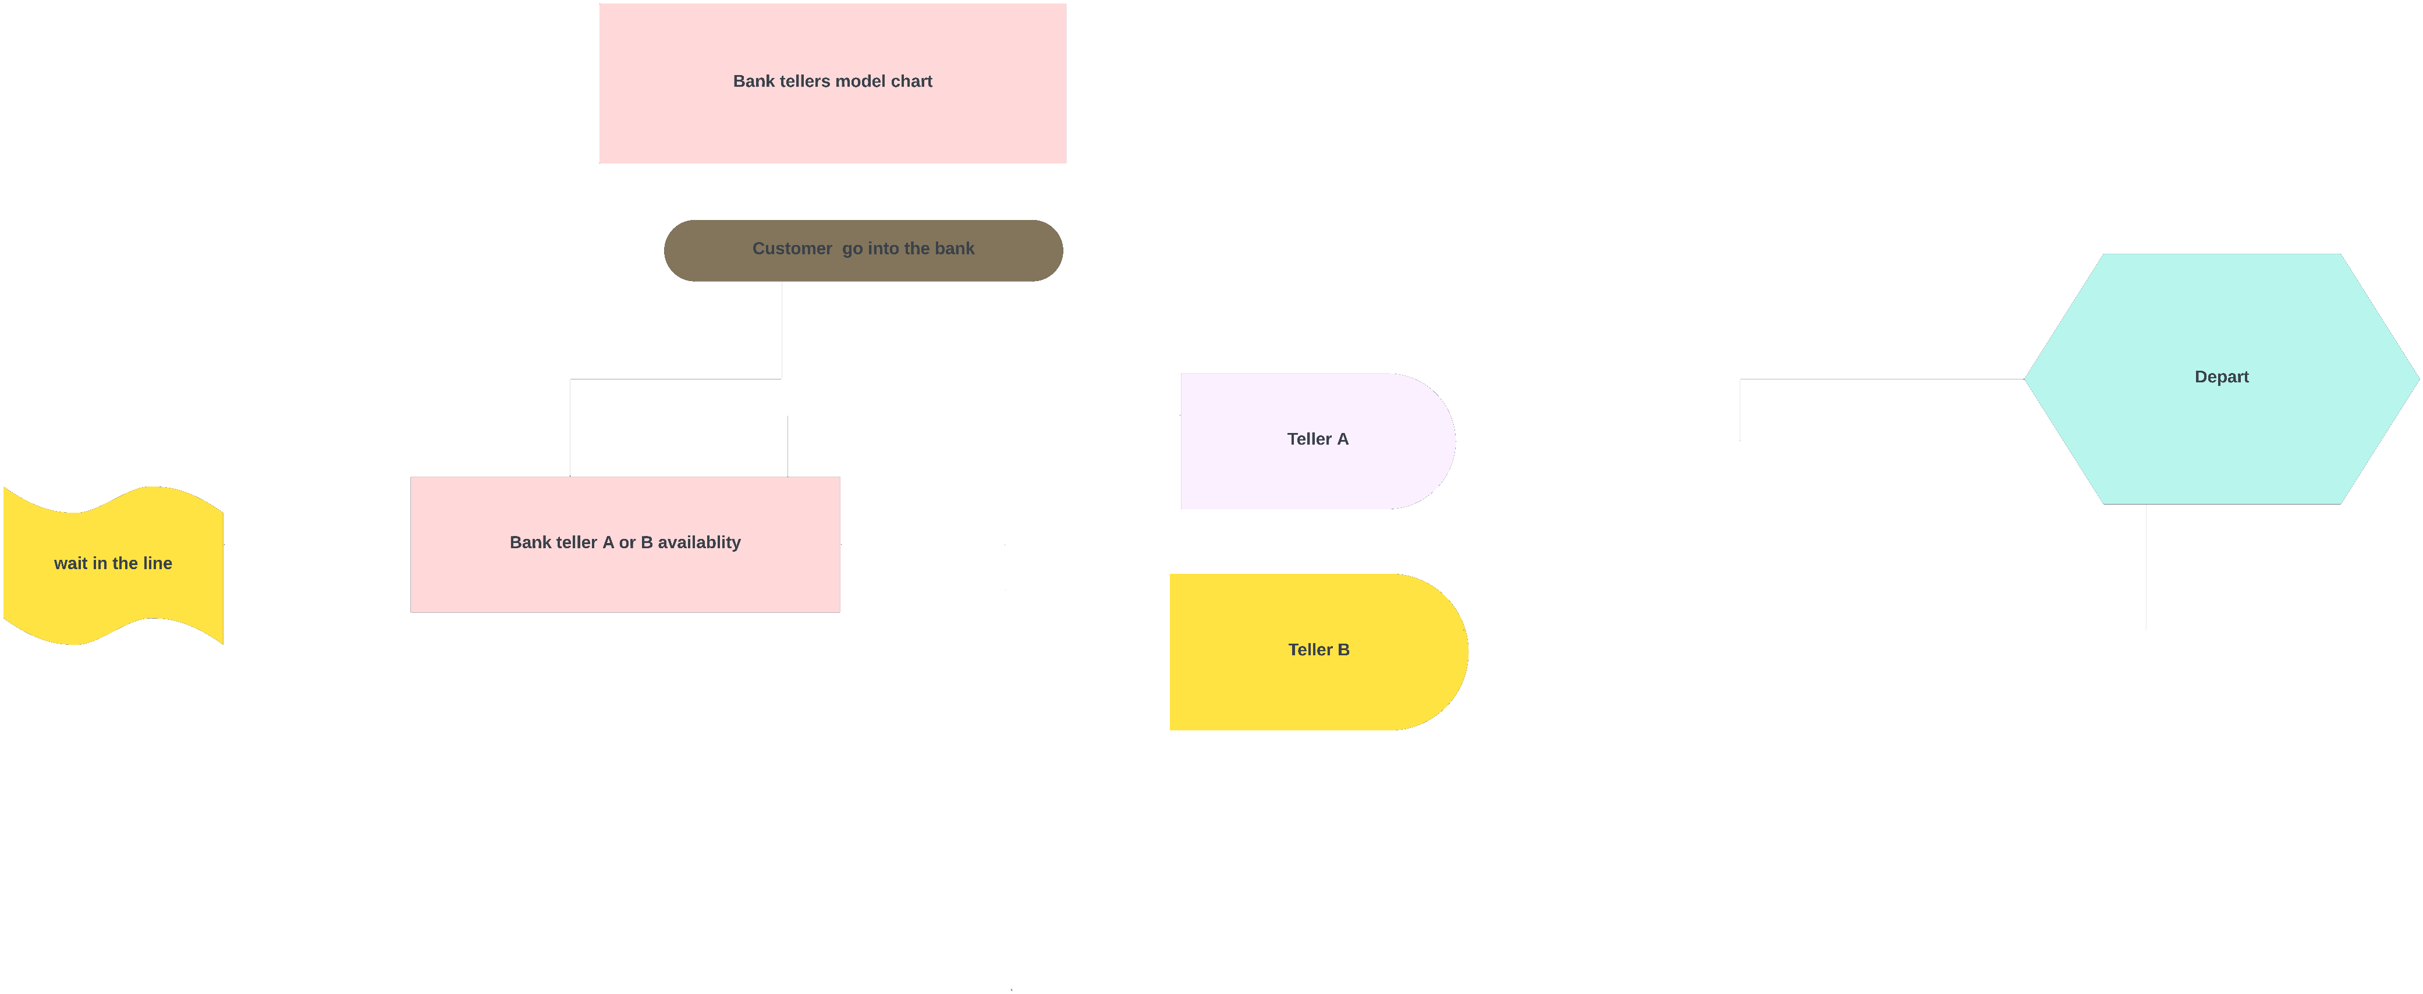
Flow Chart

Slide 4
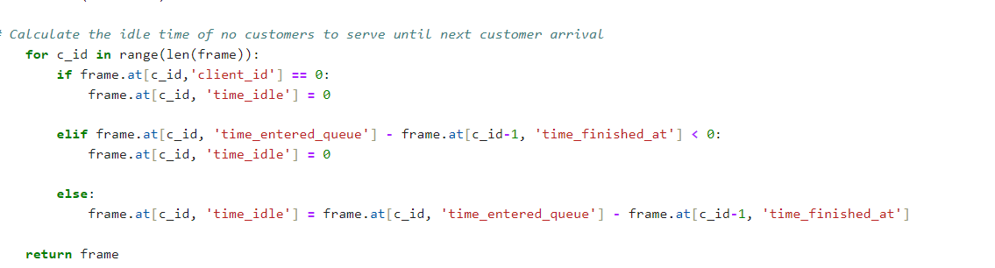
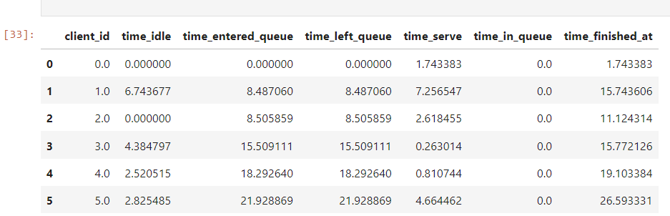
Simulation
I used code to inter the clients to the model, the waiting time, the time spent with the tellers, the idle time of the tellers and I got the data frame below .

Slide 5
The df above shows the top 6 rows result of the simulation with parameter values of 2 (capacity), 2.5 (mean inter-arrival time), and 3 (serving time, ideal serving time in the banks policy).We can see how the time elapsed from a client started queuing in the waiting line, served by a teller, to leaving the bank. For example, the client 0 arrived at the bank without queuing and went straight to the counter and left bank at 1.743383 minutes. Then all tellers have been idled for 6.743677 minutes until the second client (id=1) arrived at the bank at 8.487060 minutes.

Slide 6
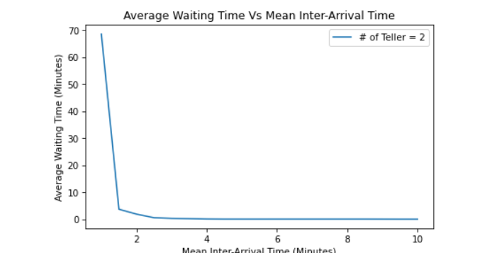
Plots
The average waiting time with variation of mean inter-arrival time with 2 tellers and mean serving time of 3 minutes. The average waiting time dropped sharply when the gap of client arrival time is at 1.5 minute and continue to have lower average waiting time for higher mean inter-arrival time.

Slide 7
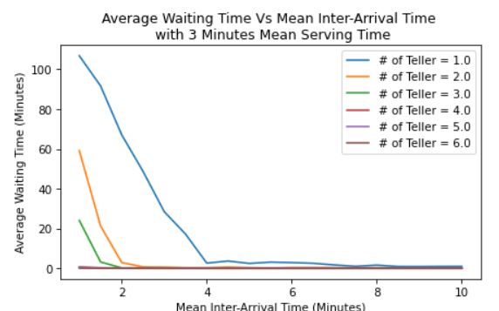
The average waiting time decreased as the inter-arrival time increased. This makes sense since the bigger the gap between clients arrived, tellers will have more times to handle transactions and less number clients queue at the waiting line. Also, we can see from the plot that 2 tellers or higher has average waiting time close to zero for mean inter-arrival time 1.5 minutes or higher.

Slide 8
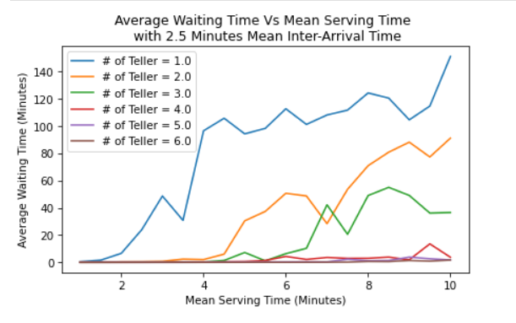
The average waiting time increased as the mean serving time increased. The longer it takes for a teller to handle transactions, there are less tellers available for the coming clients and higher waiting time for clients in the queue line. It's interesting to see that the trends of average waiting time for 4 tellers or higher has not been affected by longer serving time. It's close to zero average waiting time.

Slide 9
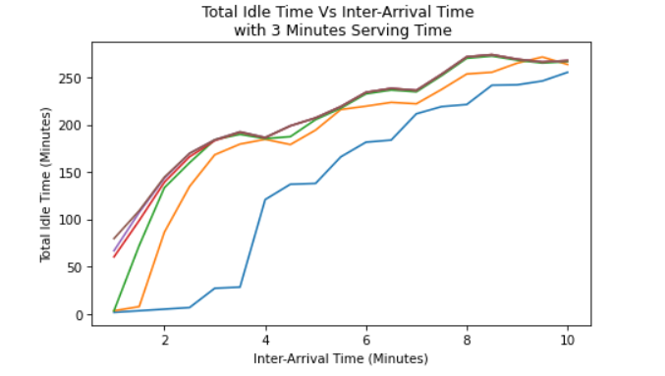
As more tellers are available to serve clients, the total idle time is also increased. 3 tellers or higher shows the same trend. When there is only one teller, it has significant less idle time compared to 2 or more tellers in place.

Slide 10
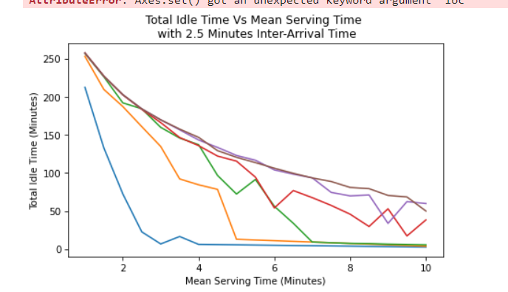
The total idle time started to decrease as the mean serving time increased. This makes a lot of sense because the longer it takes for tellers to handling transactions, they will have less idle time. The total idle time reached close to zero at 4.5 minutes mean serving time when only one teller in place.

Slide 11
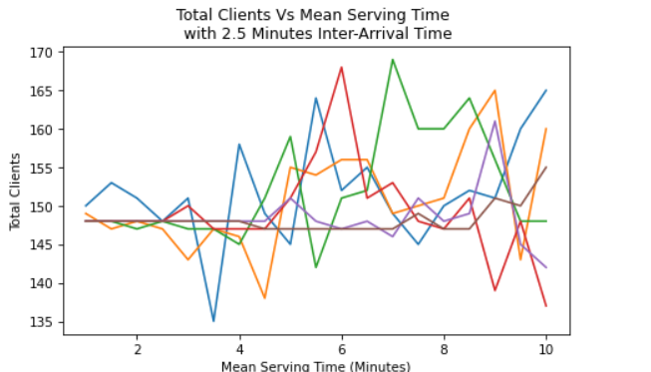
The higher the mean inter-arrival time, the less clients tellers will serve per working day. This indicates that higher mean serving time may not necessary impact the average waiting time if inter-arrival time between clients is high enough. The total number of clients that tellers can serve per working day varies also for different mean serving time and number of tellers.

Slide 12
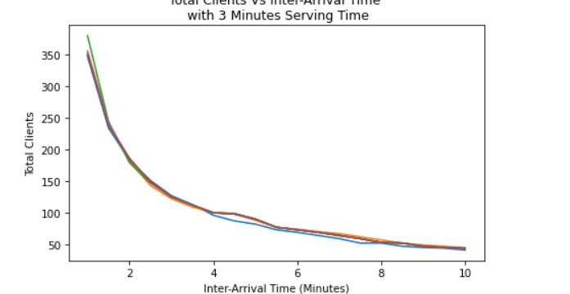
We can clearly see that 2 tellers is the optimal number of tellers to hire. 1 teller definitely is not enough to handle day to day transactions. 1 teller will require much higher mean inter-arrival time (~ 9 minutes) and much lower mean serving time. 3 tellers or more will be a waste as idling time.

Slide 13

Results

Slide 14
Conclusion
This bank teller simulation showed great results, it has demonstrated that bank executives can use this simulation to figure out the optimal number of tellers based on the mean inter-arrival time and the mean serving time for a client. To decide the number of tellers to hire, the bank executives can use reasonable parameters based on bank location and the number of clients coming in every working day looking for tellers, example in big city the bank will definitely need then 2 tellers.

Slide 15
Thank you !

